Slide 1
Chương 5: Digital MARKETING MIX

Slide 2
Objectives
Applying the original marketing mix into the digital environment
Describe the marketing mix
Evaluate the elements of marketing mix in the digital environment

Slide 3
Chapter content
7Ps of Marketing Mix
Product – Price – Place – Promotion – 3Ps in service
Internet and its implications

Slide 4
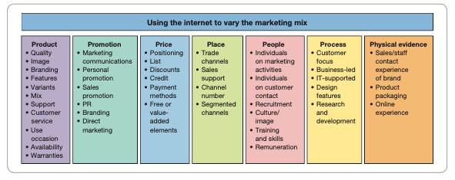
Marketing Mix

Slide 5
A new era
Advancement of marketing mix toward relationship development (Berry, 2008)
Increased complexity of the technology environment and consumer demands (Singh et al., 2011)
Value co-creation between consumer and firm (Vargo and Lusch, 2004)

Slide 6
Digital opportunities
Various the application of the marketing mix
New routes to achieve competitive and differential advantage
New market position
Innovative ways to build and nuture relationship
No time and space barriers
Continuous and instantaneous access to product and service

Slide 7
Product
Digital branding
The process by which companies distinguish their product offerings from the competition by the sum of the chracteristics of the product or service as perceived by the customer
Add value across the supply chain
Barrier to competition, increase trust, and generate profit

Slide 8
Product
Digital branding
Physical (traditional) product = core product + brand name + service
Online environment:
Not only manufacturers and products
ALL Businesses are perceived as brands

Slide 9
Product
Brand equity (Tài sản thương hiệu)
Brand domain: tên miền đại diện của thương hiệu trên Internet
Brand heritage: di sản thương hiệu
Brand values: giá trị của thương thiệu
Brand assets: tài sản nhận diện thương hiệu
Brand personality: cá tính của thương hiệu
Brand reflection: các yếu tố phản ánh thương hiệu, bao gồm KHMT
Notes:
These principles of branding apply online and offline, but online brands increasingly need to ensure integration between the perception of their offer in both digital and physical environments.

Slide 10
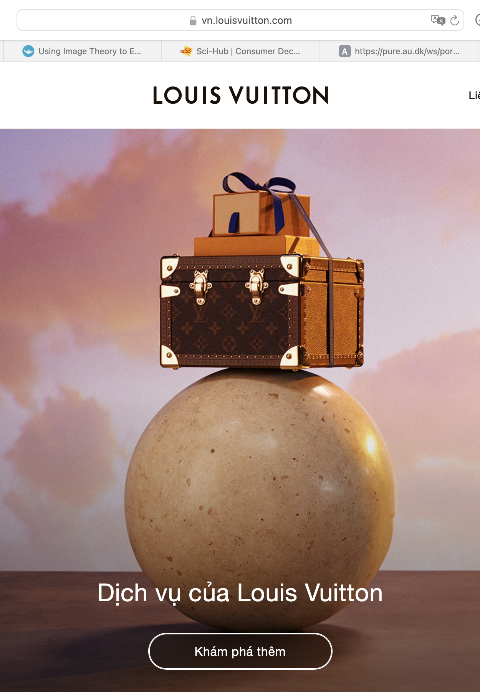


Slide 11
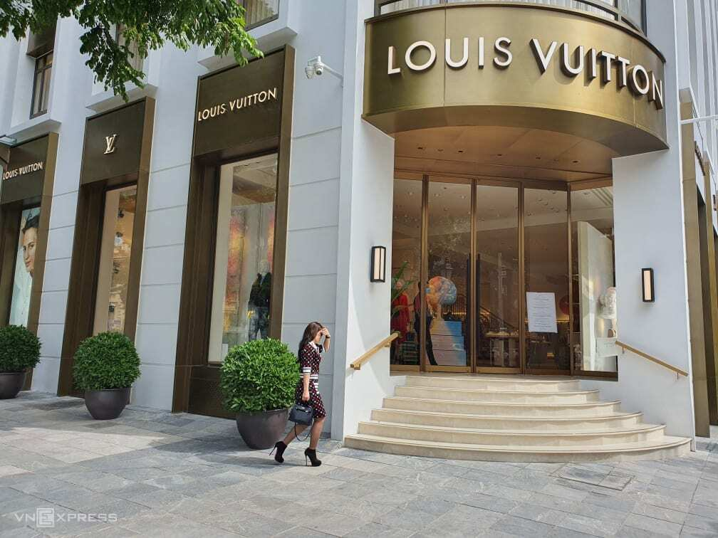

Slide 12
Product
Brand equity (Tài sản thương hiệu)
Brand domain: tên miền đại diện của thương hiệu trên Internet
Brand heritage: di sản thương hiệu
Brand values: giá trị của thương thiệu
Brand assets: tài sản nhận diện thương hiệu
Brand personality: cá tính của thương hiệu
Brand reflection: các yếu tố phản ánh thương hiệu, bao gồm KHMT
It is very important to ensure online and offline consistency
Notes:
These principles of branding apply online and offline, but online brands increasingly need to ensure integration between the perception of their offer in both digital and physical environments.

Slide 13
Product
The online context changes the branding game
Information rich
dynamic
Excessive information flows
Technologically innovative

Slide 14
Product
03 Success factors for online branding:
Brand avocacy (sự ủng hộ thương hiệu)
Brand identity (Bản sắc thương hiệu)
Brand names for online brand (tên nhãn hiệu đối với nhãn hiệu trực tuyến)

Slide 15
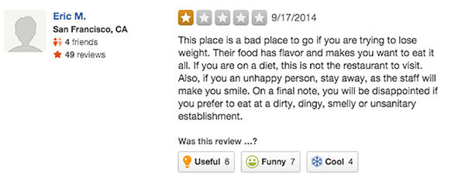
Product
Brand avocacy (sự ủng hộ thương hiệu )
Brand advocate: a customer who has favourable perceptions of a brand and will talk favourably about a brand to their accquatainces to help generate awareness of the brand or influence purchase intent
Online Brand advocacy is multidimensional, having cognitive, affective, and virtual visal cues as well as uniwue forms of online communication (highly visual, global reach, more permanent)
Notes:
90% người tiêu dùng tin tưởng brand advocate
Chỉ 20% tin quảng cáo online

Slide 16
Product
Brand avocacy (sự ủng hộ thương hiệu )
Brand advocate: a customer who has favourable perceptions of a brand and will talk favourably about a brand to their accquatainces to help generate awareness of the brand or influence purchase intent
Online Brand advocacy is multidimensional, having cognitive, affective, and virtual visal cues as well as uniwue forms of online communication (highly visual, global reach, more permanent)
Brands seek to encourage online brand advocacy through events, which stimulate customer engagement
MCU #teamcaptain và #teamIronman
Notes:
90% người tiêu dùng tin tưởng brand advocate
Chỉ 20% tin quảng cáo online

Slide 17
Product
Brand identity (Bản sắc thương hiệu)
Individual and unique attritbutes
More than just the name:
logo, slogan, packaging…
Product (attributes, quality, uses, users..)
Organisation (innovativeness, vision, culture... )
Communication (ad, KOL, promotion...)
Servicescape and experience (site, atmosphere, reputation, feedback...)

Slide 18
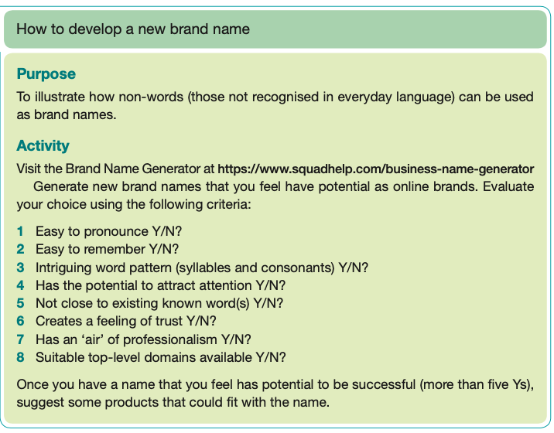
Product
Brand names for online brand

Slide 19
Product
Core product and extended product
Core product: the fundamental features of the product that meet the user’s need
Extended product: additional features and benefits beyond the core product
4 main implications of digital technology for the product
Varying the core product
Change the extended product
Offering digital product
Product development
Notes:
6 in the book, but we can cut it down to 4

Slide 20
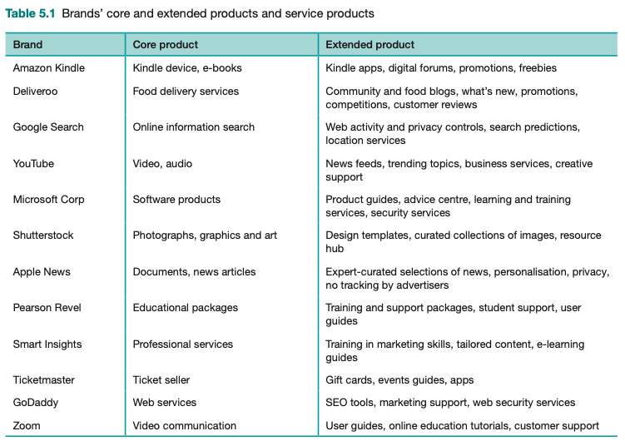
Product
(1)Vary the core product (online)
Adding ‘digital value’ to customer (Ghosh, 1998)
Aditional information or transaction services
Needs of new customer segment
Create new source of value
Negative impact to current business?
Mass customisation
Use the internet to change the range or combination of products
Notes:
can I address the needs of new customer segments by repackaging my current informa- tion assets or by creating new business propositions using the internet?

Slide 21
Product
(2) Changing the extended product
How internet can be used to vary the extended product (Chaffey & Smith, 2017):
warranties
testimonies
Customer services
Tools supporting production’s selection and usage
Example: ZOOM
Core product: online meeting (restricted participants and time), free
Extended product: paid (various packages), audience size, record ...

Slide 22
Product
(3) Digital products: offer digital products such as content, music, or video.
Example of purchase options at different price points:
Subscription (thu phí định kỳ)
Licensing (trả phí theo gói đăng ký)
Pay-per-view (trả theo mượt xem)
Ad-supported content (không tính phí người dùng, thu tiền quảng cáo)

Slide 23
Product
(4) New product development
Lower research cost
example: online survey; social media listening; web analytics
Faster development
Rapid development, testing, and exploring option
Easier to locate partners
Faster diffusion
Need to bring the product internationally
WoM increases acceptation, especially through the Internet

Slide 24
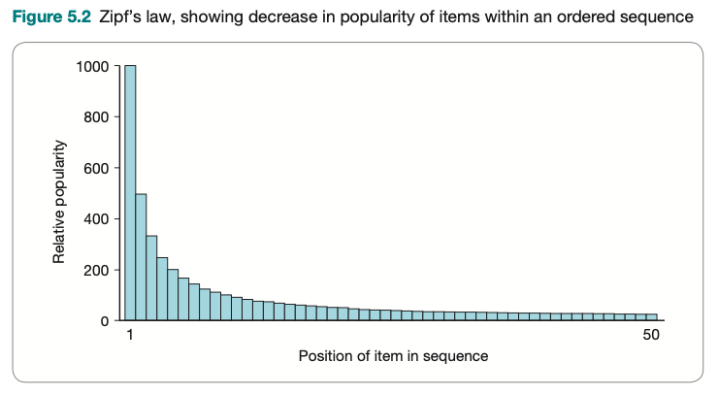
Product
Opportunities for new product
Niche market now has big value
Long tail Model from Anderson (2004)
Small number of products account for most of the volume
But the other products (niche) are collectively significant

Slide 25
Price
4 implications of Internet
Increase price transparency
Price uncertainty
Innovative pricing approaches
Alternative pricing structure or policies
Notes:
Chính sách giá và mô hình giá cho sản phẩm/dịch vụ
Rất khó khăn để quyết định chính sách giá trên môi trường trực tuyến

Slide 26
Price
Increase price transparency
The consumers have increasing access to pricing information
Price comparison sites
Inelastic online pricing: tiny impact from price increase to demand
Price is just one of the many factors to consier
“Satisficing behaviour” - “bounced rationality” (Herbert Simon – 1957)
Many references website before purchase (on average 38 sites)
Most wont try too hard
Notes:
The term ‘satisfice’ was coined by Herbert Simon in 1957 when he said that people are only ‘rational enough’ and that they suspend or relax their rationality if they feel it is no longer required. This is called ‘bounded rationality’ by cognitive psycholo- gists. In other words, although consumers may seek to minimise some variable (such as price) when making a product or supplier selection, most may not try too hard.

Slide 27
Price
(2) Price uncertainty
Consumers compare before purchasing
Third party support
Variability can reduce uncertainty
High variability: dynamic pricing, based on real demand (Grab)
Low variability: everyday low pricing (Aldi)
Combined to price transparency to boost performance

Slide 28
Price
(3) New approach to pricing
Technology enable new pricing approaches
Auction
Dynamic pricing
Shipping fees

Slide 29
Price
(4) Alternative pricing structure or policies
digital product needs new pricing
Factors to consider
Basic price
Discount
Extra products/services (add-on)
Refund policies
Cancellation terms

Slide 30
Place
To maximise reach and minimise
New way to reach consumers in digital environment
4 implications of digital place
Point of purchase
New channel structure
Channel conflix
Virtual organisations

Slide 31
Place
(1) Point of purchase
Logistic is still vital for traditional product
Digital products erase the logistics barriers, easier to reach
Navigational advantage
Reach (tiếp cận)
Richness (độ chi tiết của thông tin thu thập và cung cấp từ/cho khách hàng)
Affiliation (đối tác)
Localisation
Easier to adapt (culture, practices)

Slide 32
Place
(2) New channel structures:
Disintermediation
Reintermediation
Countermediation
A strategic reaction to counter intermediaries
Example: Opodo vs. Lastminute

Slide 33
Place
(3) Channel conflicts
Conflict of interest with current partners (Frazier, 1999)
Occur when developing internet-related channel
Need to consider different forms of channel
Communication channel only
Distribution channel to intermediaries
Direct sales channel to customers
Any combination of the above
Conflict avoidance strategy (Kumar 1999)
Notes:
Kumar gợi ý các chiến lược né xung đột sau;
Không bán trên internet
Bán internet qua trung gian (reseller)
Chỉ nhà sản xuất bán trên mạng (nếu chưa có reseller)
Bán hết qua internet,không kiểm soát
Nhượng quyền

Slide 34
Place
(4) Virtual organisation
Not bounded by physical limits
Online management
Cost effective
Example
Google Ad
Paypal
Google Analytics
Guru.com / Work.com

Slide 35
Promotion
More in chapter 8 and 9
Additional communication to consumers
How internet can be used to vary the promotion element of the marketing mix:
New way to apply communication mix
Internet in different sages of the buying processes
Promotional tools to assist marketing objectives (relationship; retention...)

Slide 36
People, process, and physical evidence
Service marketing mix
Tend to change
Digital potential
Substitution (of people)
Complementary (add to service)
Displacement (move elsewhere)
Service disruptors (new kind of service)
Sharing economy
Trust and online reputation
Consumer expectation

Slide 37
People, process, and physical evidence
People
Peer-to-peer service
Relationship between employee-customer
Replaced by automated process
Challenges in effective implementation

Slide 38
People, process, and physical evidence
Process
The methods and procedures companies use to achieve all marketing functions
to consider:
Preferred channel - customer
Preferred channel - organisation
New tools (live chat)

Slide 39
People, process, and physical evidence
Physical Evidence
The tangigle expression of a product and how it is purchased and used
Many new approaches post-covid
360 photo/video in real estate
Virtual exhibition

Slide 40
Summary
7 Ps of Digital marketing mix
Impact of digital environment on the implementation of the mix

Slide 41


